Slide 1
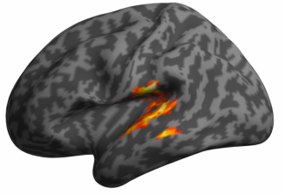
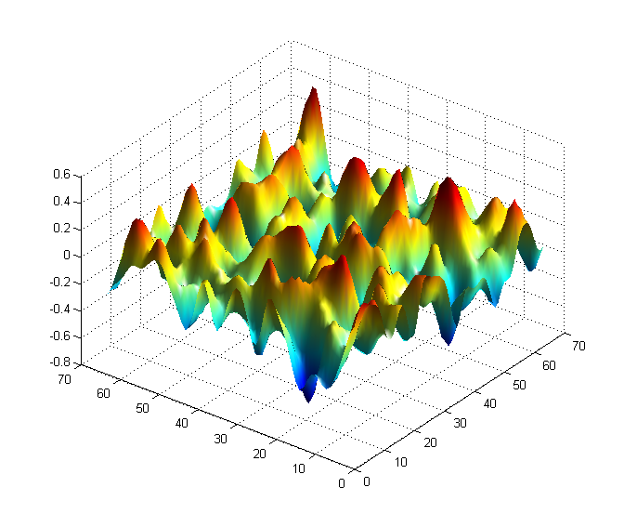
Random field theory for multi-comparison correction
Journal Club, Summer special edition
Notes:
Hello everybody, I’ll start by quickly introduce myself. My name is Kilian Hett, I’m a postdoctoral researcher working for the Medical Image Computing Lab.
Today and Friday I’m going to give you a lecture about automatic methods for brain structures segmentation.
----------------------------------
Thank you Ipek, for this introduction, so as Dr. Oguz just told you,
Today and also Friday, I’m going to give you a lecture about automated methods for the segmentation of brain structures.

Slide 2
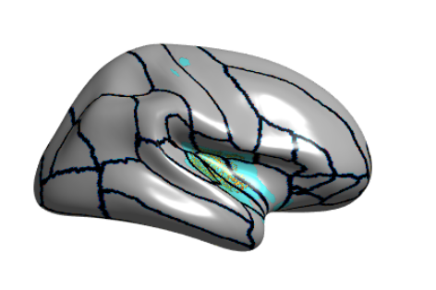
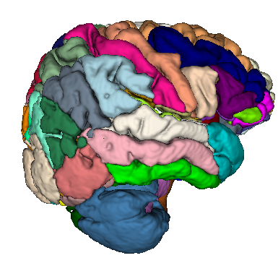
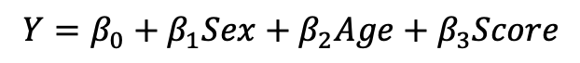
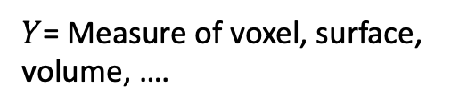
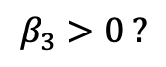
Classical analysis pipeline
Feature estimation (Preprocessing+
Processing)
GLM or LMM
Statistical Inference
$Y$= Measure of voxel, surface,
volume, ….
$$Y=β_{0}+β_{1}Sex+β_{2}Age+β_{3}Score$$
$$β_{3}>0 ?$$
Y
Score

Slide 3
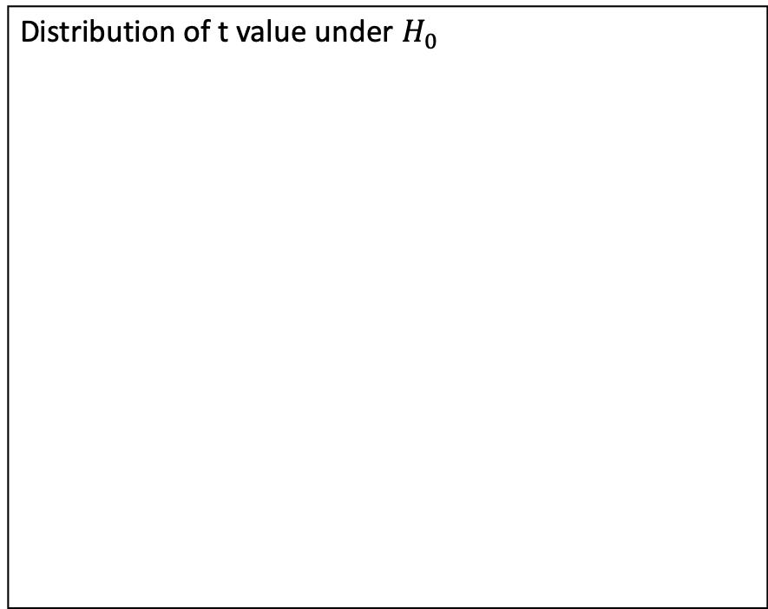
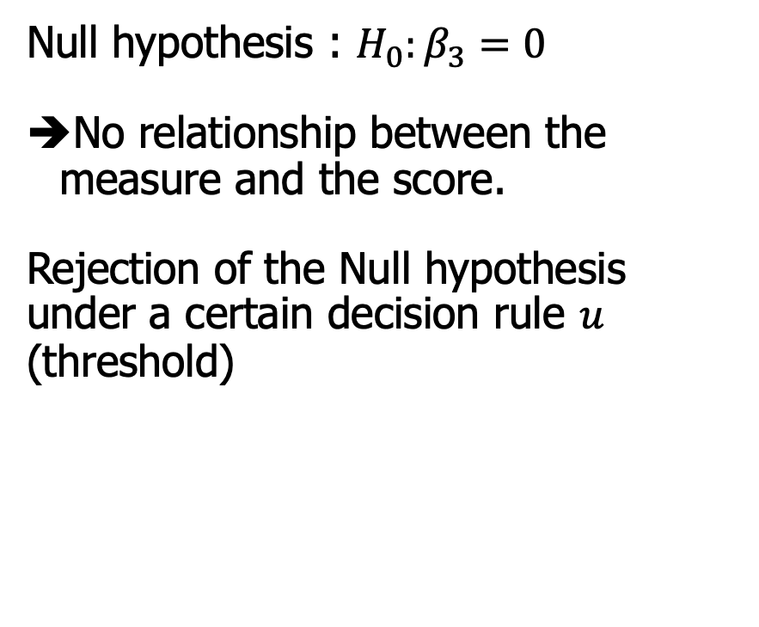
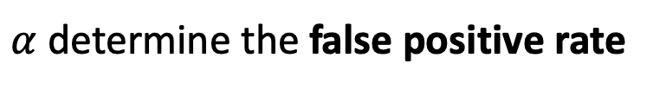
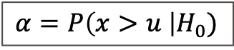
Statistical inference
Distribution of t value under $H_{0}$
u
Null hypothesis : $H_{0}:β_{3}=0$
No relationship between the measure and the score.
Rejection of the Null hypothesis under a certain decision rule $u$ (threshold)
$α$ determine the false positive rate
$$α=P\left(x>u \right|H_{0})$$

Slide 4
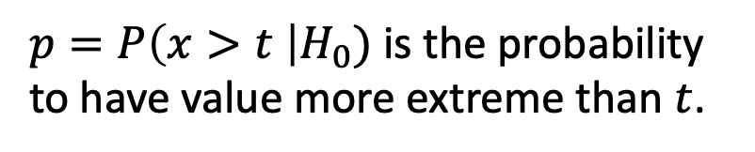
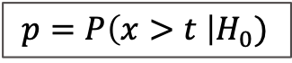


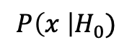
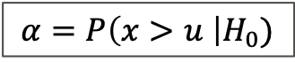

In other words
Distribution of t-value under $H_{0}$
$p=P\left(x>t \right|H_{0})$ is the probability to have value more extreme than $t$.
Reject $H_{0} if:$
$t>u$
or (equivalent)
$p<α$
$$p=P\left(x>t \right|H_{0})$$
$$α=P\left(x>u \right|H_{0})$$
t
u
$$P\left(x \right|H_{0})$$

Slide 5
Multiple comparisons
Family-wise error rate (FWER) is the probability of making one or more false discoveries (type I errors) when performing multiple tests.

Slide 6
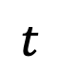
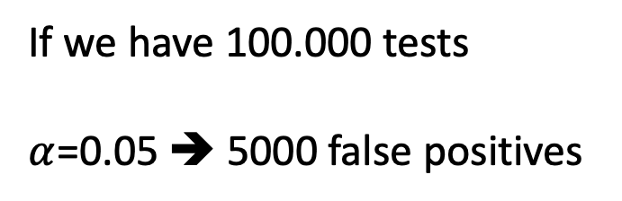
Multiple comparisons
If we have 100.000 tests
$α$=0.05 ➔ 5000 false positives
$$t$$

Slide 7
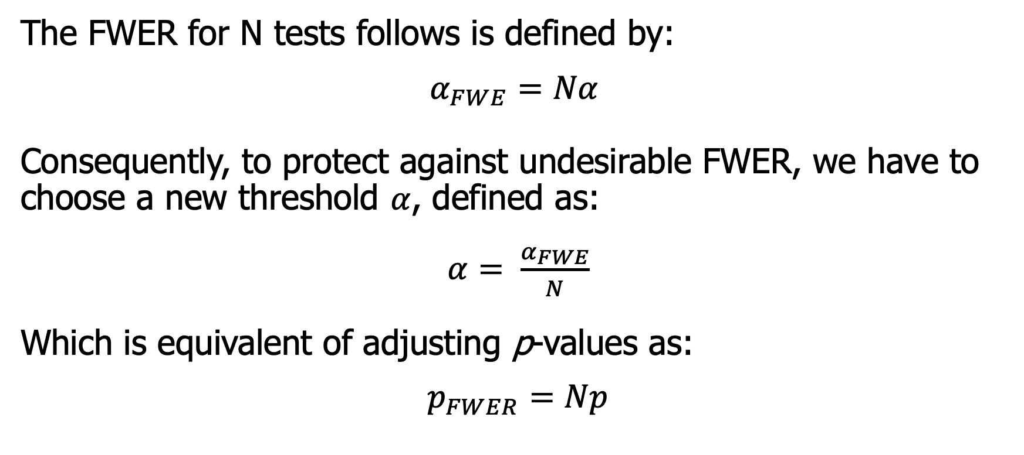
Bonferroni correction
The FWER for N tests follows is defined by:
$$α_{FWE}=Nα$$
Consequently, to protect against undesirable FWER, we have to choose a new threshold $α$, defined as:
$α= \frac{α_{FWE}}{N}$
Which is equivalent of adjusting p-values as:
$$p_{FWER}=Np$$

Slide 8
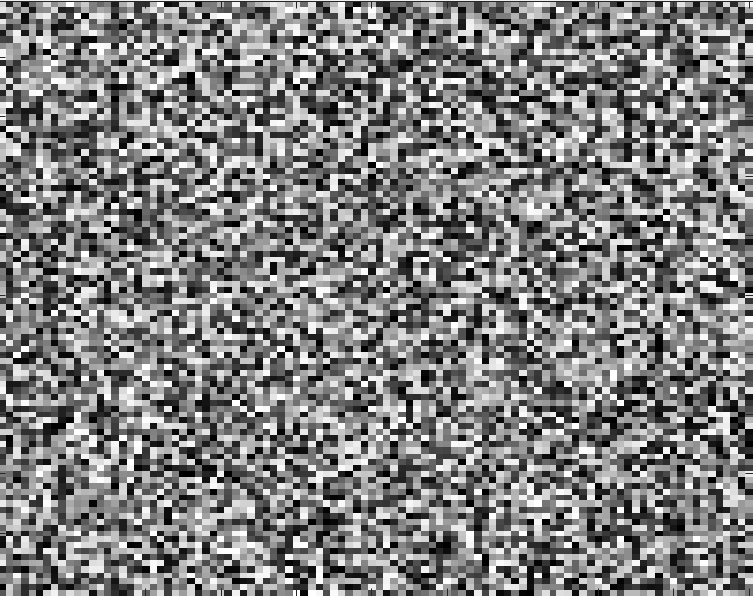
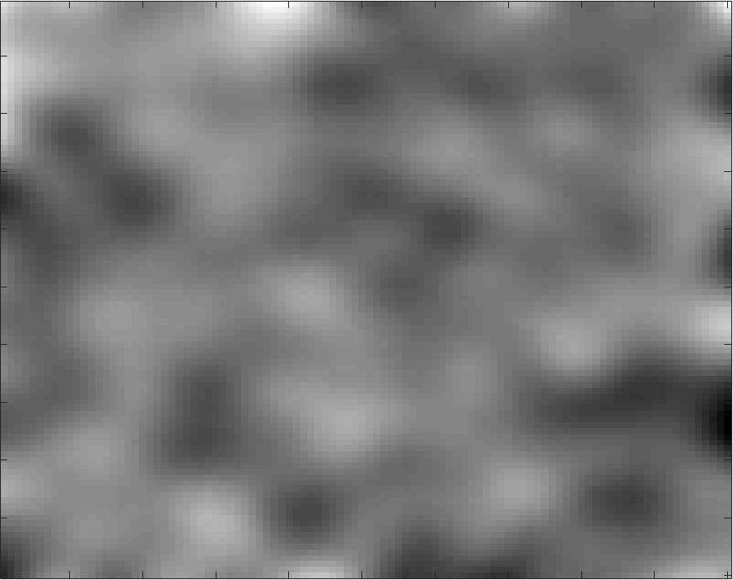
Bonferroni correction
Advantage: Bonferroni correction does not require the independence of the set of tests.
Inconvenient: Become excessively conservative for dependent tests.

Slide 9
Bonferroni correction
100 x 100 independent tests
100 x 100 spatially correlated tests
N = 10.000, with Bonferroni correction: $α=5.{10}^{−4}$
Bonferroni is too conservative for correlated tests!

Slide 10
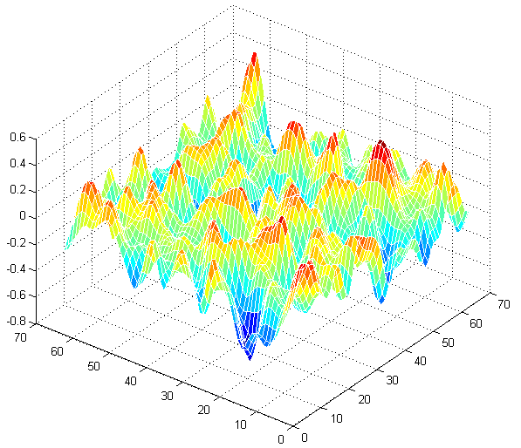
Random field theory
The statistic field is assumed to be a good lattice representation of an underlying continuous stationary random field.
lattice representation

Slide 11
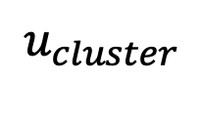
Topological inference
Statistical level
Topological features
Peak height
Cluster extent
$$u_{cluster}$$
space

Slide 12
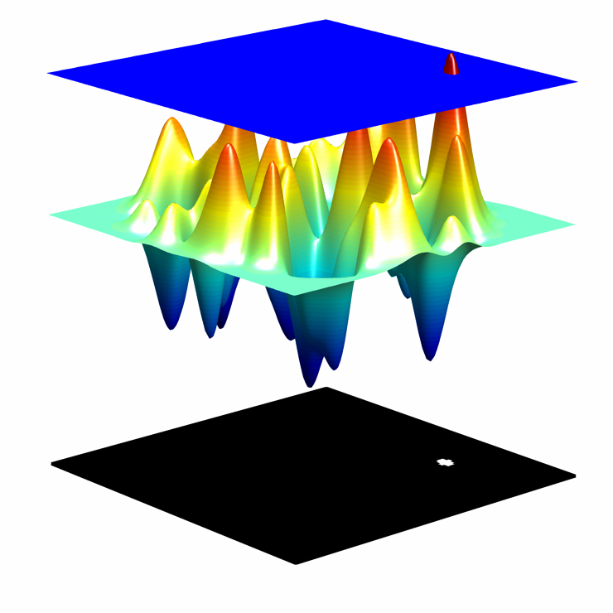
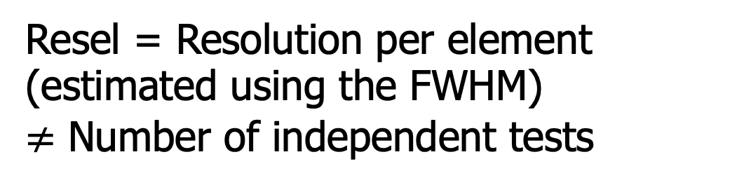
Two properties
Euler Characteristic
at high threshold = numbers of blobs
Resel = Resolution per element
(estimated using the FWHM)
$≠$ Number of independent tests

Slide 13
Cluster extends
Statistical level
$$u_{cluster}$$
space

Slide 14
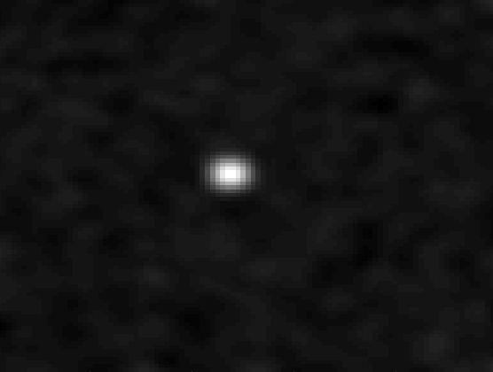
Cluster extends
Neighboring voxels are not activated independently from each other but are activated together in clusters.
T-map

Slide 15
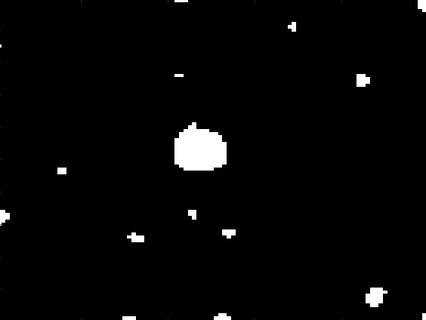
Cluster extends
Neighboring voxels are not activated independently from each other but are activated together in clusters.
t > u
T-map
Cluster

Slide 16
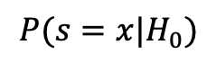
Cluster extends
Neighboring voxels are not activated independently from each other but are activated together in clusters.
$$P(s=x|H_{0})$$
t > u
T-map
Cluster
Cluster size

Slide 17
Cluster extends
Neighboring voxels are not activated independently from each other but are activated together in clusters.
$$P(s=x|H_{0})$$
t > u
T-map
Cluster
Cluster size
$p_{clus}= P\left(s>S \right| H_{0})=e^{−β2/D}$, where $β$ depends of the resel and the size of the cluster, and $u$.
[Friston et. al 1994]

Slide 18
Correction of local maxima
Statistical level
space

Slide 19
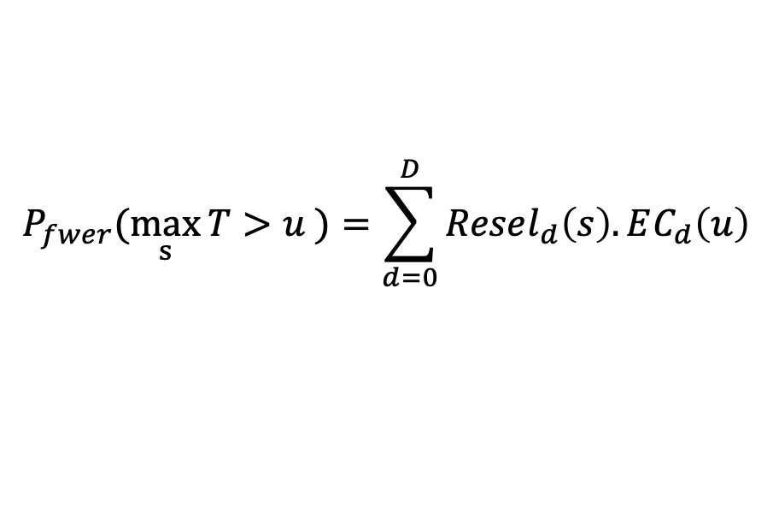
Correction of local maxima
Correction of p-value around local maxima
Use the Euler characteristics to estimate the p-value corrected for FWER.
$$P_{fwer}(\max_{s}{T>u )=\sum_{d=0}^{D}{Resel_{d}\left(s\right). EC_{d}\left(u\right)} }$$

Slide 20
Correction of local maxima
Correction of p-value around local maxima
Use the Euler characteristics to estimate the p-value corrected for a specific FWER.
$$P_{fwer}(\max_{s}{T>u )=\sum_{d=0}^{D}{Resel_{d}\left(s\right). EC_{d}\left(u\right)} }$$
Depends of the “smoothness” of the data

Slide 21
Correction of local maxima
Correction of p-value around local maxima
Use the Euler characteristics to estimate the p-value corrected for a specific FWER.
$$P_{fwer}(\max_{s}{T>u )=\sum_{d=0}^{D}{Resel_{d}\left(s\right). EC_{d}\left(u\right)} }$$
Depends of the “smoothness” of the data
Depends of the threshold level

Slide 22
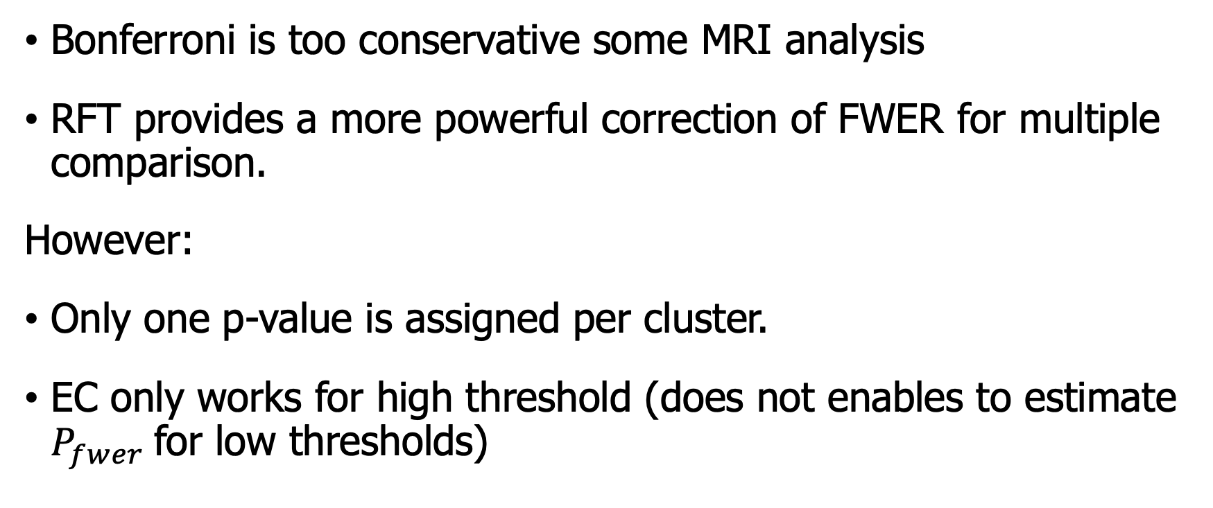
Conclusion
Bonferroni is too conservative some MRI analysis
RFT provides a more powerful correction of FWER for multiple comparison.
However:
Only one p-value is assigned per cluster.
EC only works for high threshold (does not enables to estimate $P_{fwer}$for low thresholds)

Slide 23
References
Local Maxima
[1] Worsley, K. J., Marrett, S., Neelin, P., Vandal, A. C., Friston, K. J., & Evans, A. C. (1996). A unified statistical approach for determining significant signals in images of cerebral activation. Human Brain Mapping, 4(1), 58–73. https://doi.org/10.1002/(SICI)1097-0193(1996)4:1<58::AID-HBM4>3.0.CO;2-O
[2] Worsley, K. J., Andermann, M., Koulis, T., MacDonald, D., & Evans, A. C. (1999). Detecting changes in nonisotropic images. Human Brain Mapping, 8(2‐3), 98–101. https://doi.org/10.1002/(SICI)1097-0193(1999)8:2/3<98::AID-HBM5>3.0.CO;2-F
[3] Worsley, K. J. (2005). An improved theoretical P value for SPMs based on discrete local maxima. NeuroImage, 28(4), 1056–1062. https://doi.org/10.1016/j.neuroimage.2005.06.053
Cluster extend
[4] Friston, K. J., Worsley, K. J., Frackowiak, R. S. J., Mazziotta, J. C., & Evans, A. C. (1994). Assessing the significance of focal activations using their spatial extent. Human Brain Mapping, 1(3), 210–220. https://doi.org/10.1002/hbm.460010306
[5] Cao, J. (1999). THE SIZE OF THE CONNECTED COMPONENTS OF EXCURSION SETS OF χ 2 , t AND F FIELDS. Adv. Appl. Prob. (SGSA), 31 (3), 579–595. https://doi.org/10.1239/aap/1029955192

Slide 24
Tools
Volumetric analysis: SPM (Matlab) https://www.fil.ion.ucl.ac.uk/spm/
Surface + Volumetric analysis: SurfStat (Matlab) http://www.math.mcgill.ca/keith/surfstat/

Slide 25
Thank you for your attention!
Notes:
As all of you, I hope, already know, the brain is an organ that serves as the center of the nervous system. It is a complicated organ divided in different interconnected structures, each one having distinct characteristics and functions.
For example on this coronal view you can see the hippocampus (in the red box), which the central region for our memory which is also strongly impacted by memory related neurodegenerative disease as Alzheimer disease for example,
And the putamen (in the blue box) managing a lot of our motor functions that is also impacted by disease affecting motor functions, as Huntington's disease.

